Slide 1
Enterprise Portal/PSA
July 2013
Member resume upload process

Slide 2
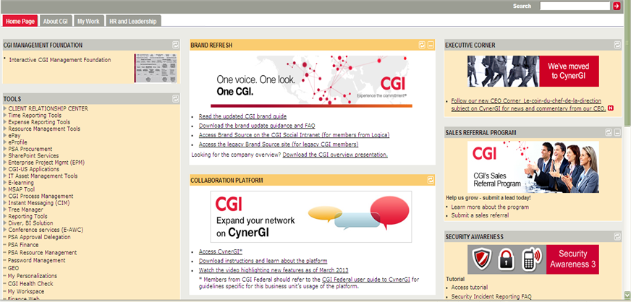
Steps to update your profile
Login to Enterprise Portal and click on the ‘Resource Management Tools’ tab

Slide 3
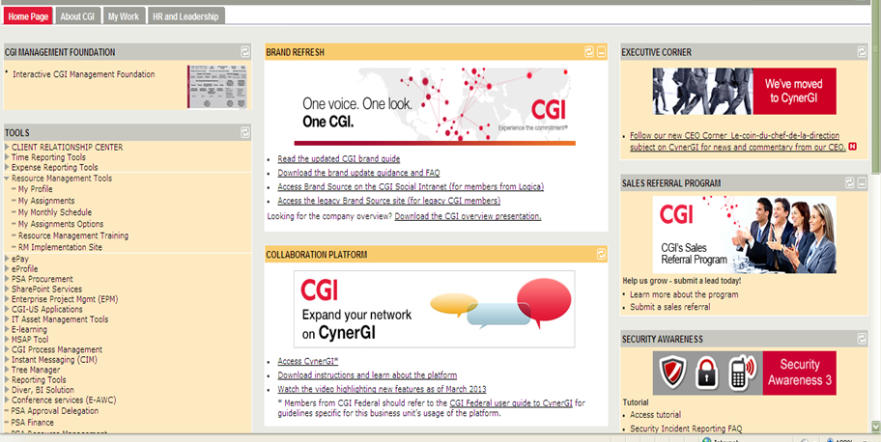
Steps to update your profile
Click on the ‘My Profile’ tab

Slide 4
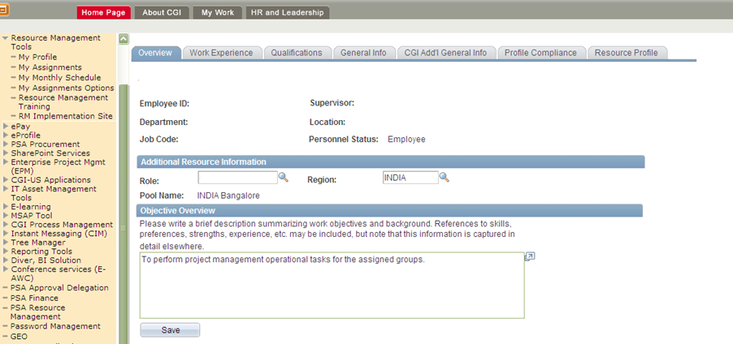
Steps to update your profile
Click on the ‘Overview’ tab and update information here

Slide 5
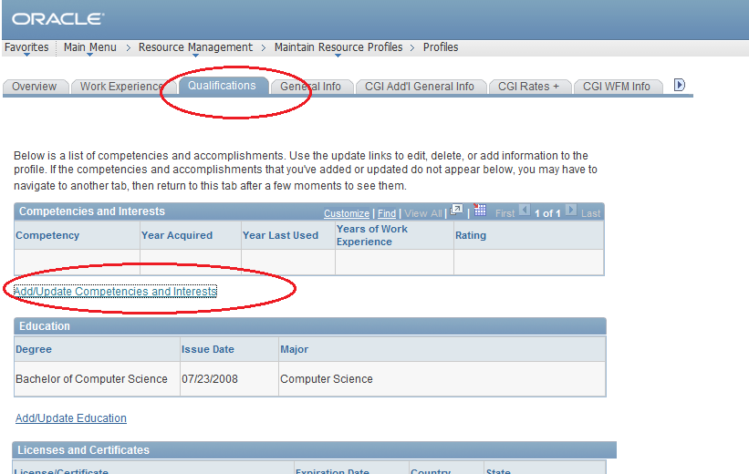
Qualifications
Click on “add/update competencies” and update your technical skills

Slide 6
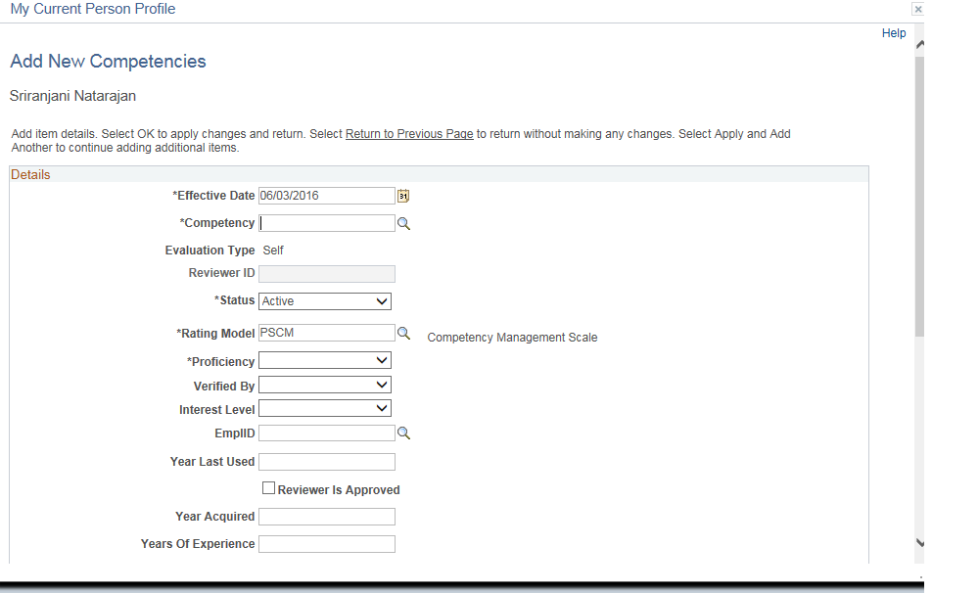
Update your competencies here

Slide 7
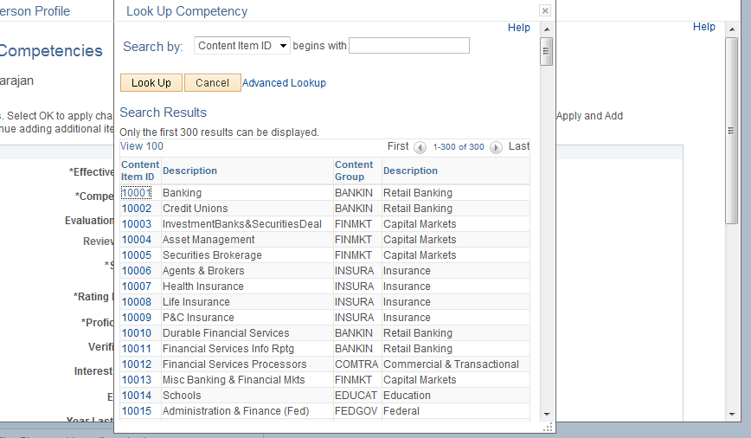
Competency List
Select your core competency(technical skills) from the list
Click on ‘Advanced lookup’ and search for specific technical skills

Slide 8
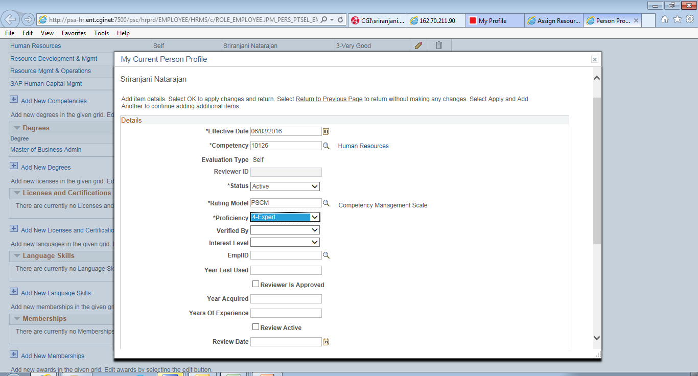
Include your proficiency level for each skill

Slide 9
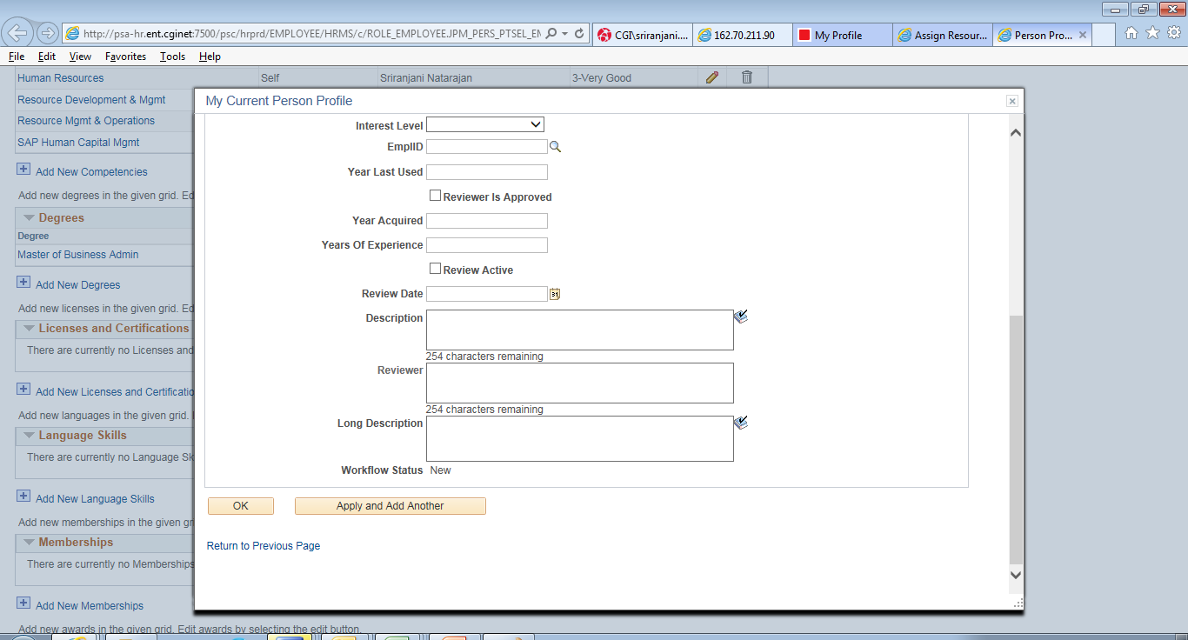
Save the changes by clicking on the ‘OK’ button

Slide 10
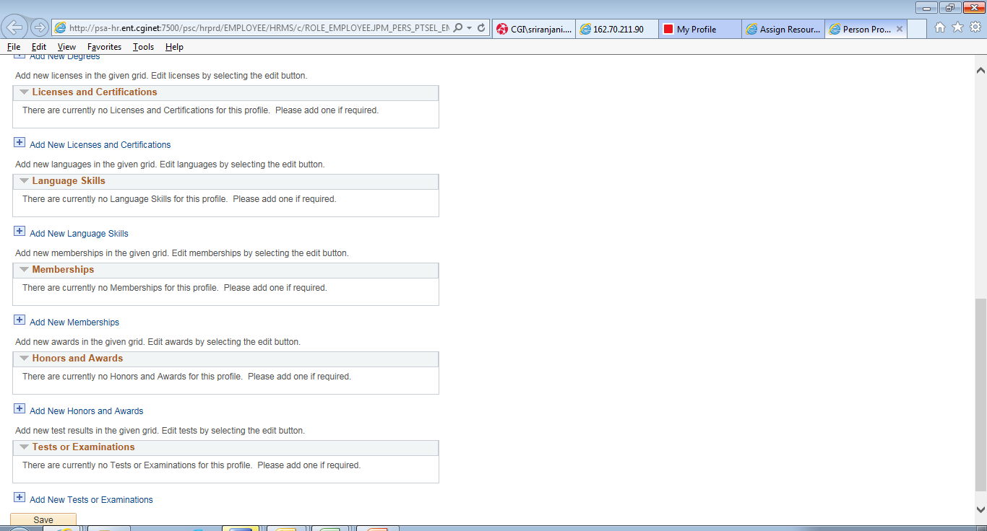
Update licenses and certification details, if any.

Slide 11
Move to ‘Profile compliance’ tab, select ‘Profile completed’ check box. Save your profile and click on ‘Notify to inform your RM and RMG SPOC of completion’

Slide 12
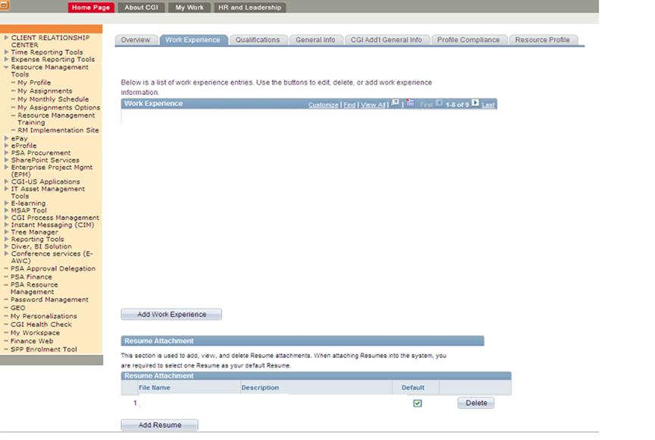
On the ‘Work Experience’ tab click on ‘Add Resume’ button and upload your profile

Slide 13
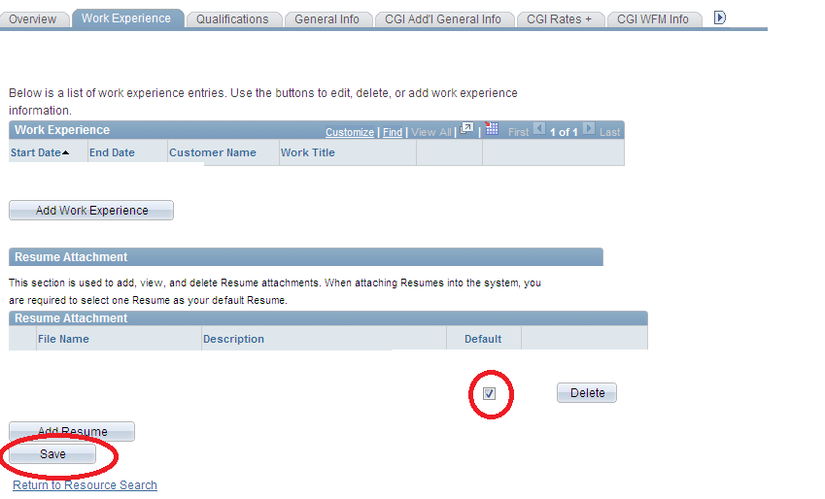
Steps to upload your resume
Click on the highlighted check box and then save

Slide 14
Thank you

